Slide 1
Topological Insulators(TI)
Band Insulator
Strong Spin Orbit Coupling
Topological Insulator
Conduction Band
Conduction Band
Conduction Band
Edge State/
Surface States
Valence Band
Valence Band
Valence Band
Hasan and Kane, Rev. Mod. Phys. 82, 3045 (2010).
Qi and Zhang, Rev. Mod. Phys. 83, 1057 (2011).
1

Slide 2
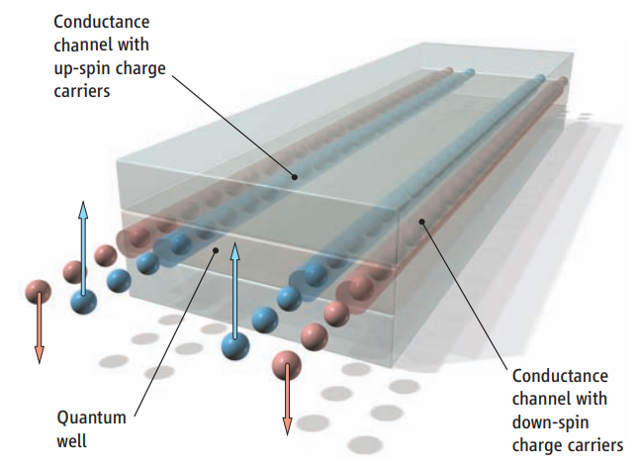
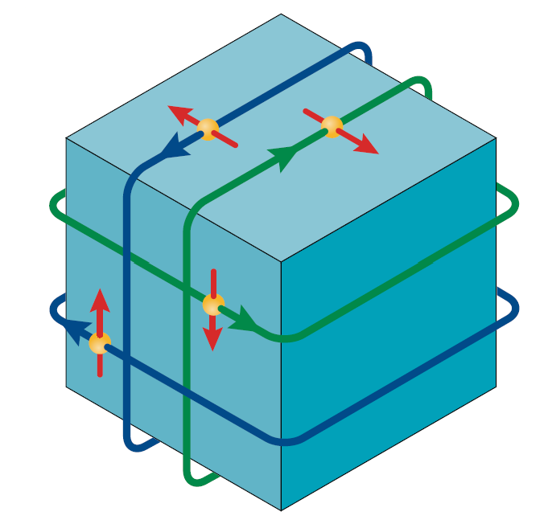
Theoretical Prediction and Realization of TI
2D TI (QSH insulator)
3D TI
HgTe quantum wells
1T’ monolayer WTe₂
Bi_{x}Sb_{1-x} alloys
Bernevig et al., Science 314, 1757 (2006).
König et al., Science 318, 766 (2007).
Fei et al., Nat. Phys. 13, 677 (2017).
Tang et al., Nat. Phys. 13, 683 (2017).
Wu et al., Science 359, 76 (2018).
Fu & Kane, Phys. Rev. B 76, 045302 (2007).
Hsieh et al., Nature 452, 970 (2008).
Bi₂Se₃ family
InAs/GaSb quantum wells
Liu et al., Phys. Rev. Lett. 100, 236601 (2008).
Knez et al., Phys. Rev. Lett. 107, 136603 (2011).
Zhang et al., Nat. Phys. 5, 438 (2009).
Xia et al., Nat. Phys. 5, 398 (2009).
Chen et al., Science 325, 178 (2009).

Slide 3
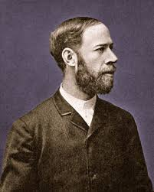
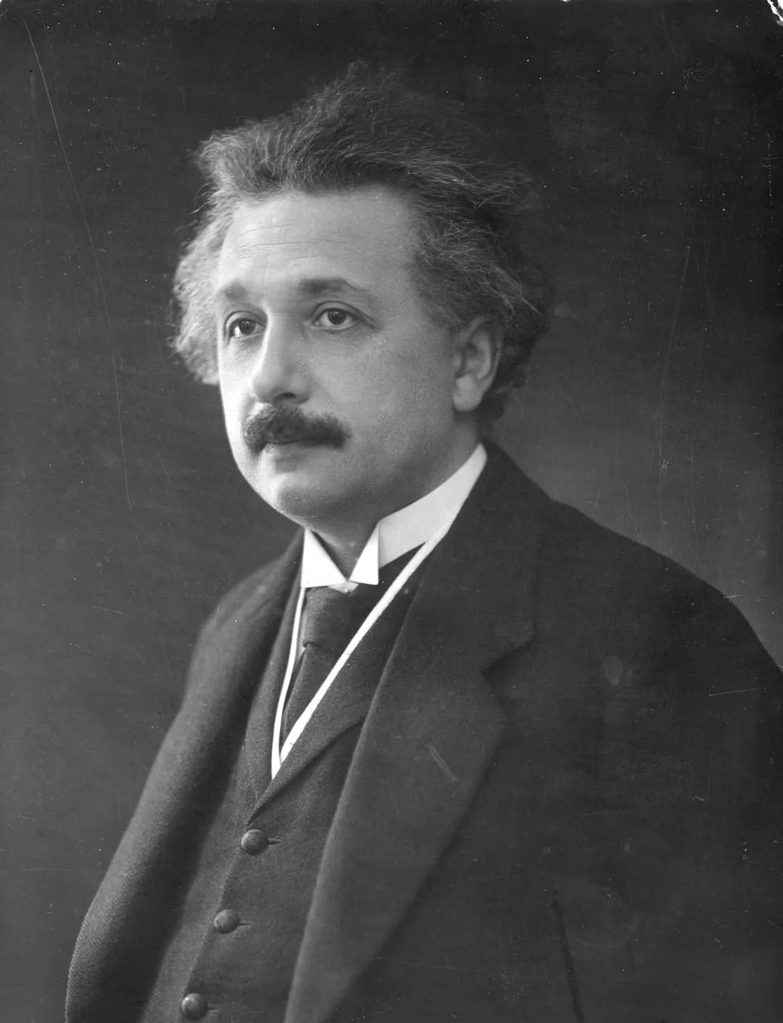
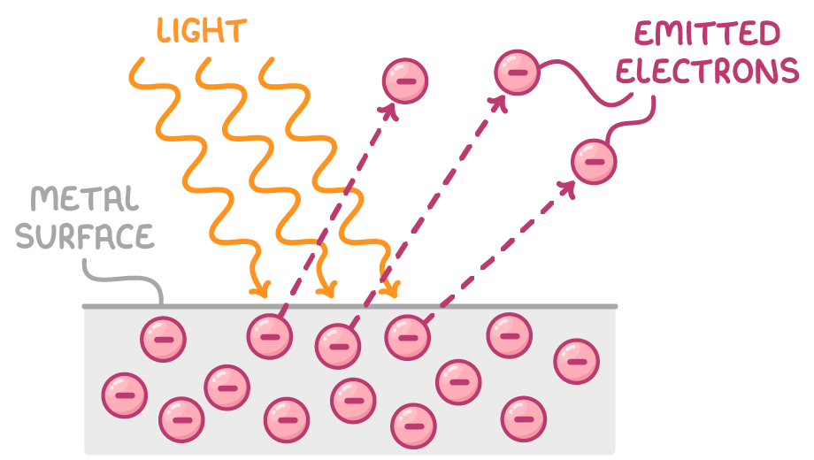
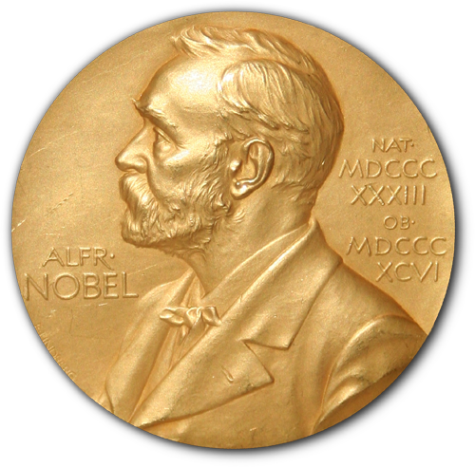
Photoelectric Effect
Heinrich Hertz
Albert Einstein
E_{kin}=hf – E_{b} – Φ
"for his services to Theoretical Physics, and especially for his discovery of the law of the photoelectric effect"

Slide 4
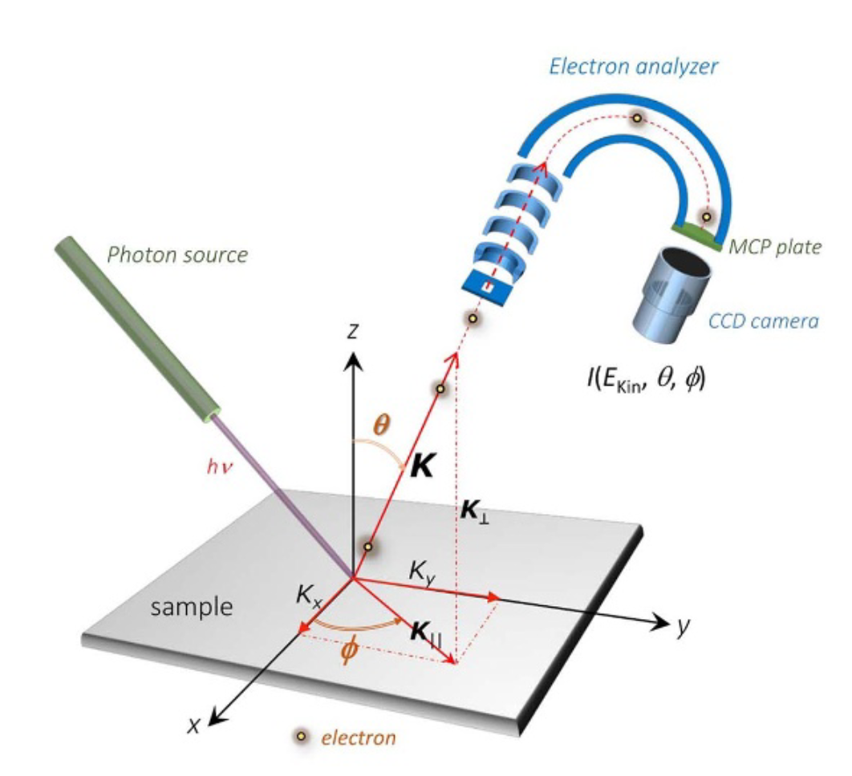
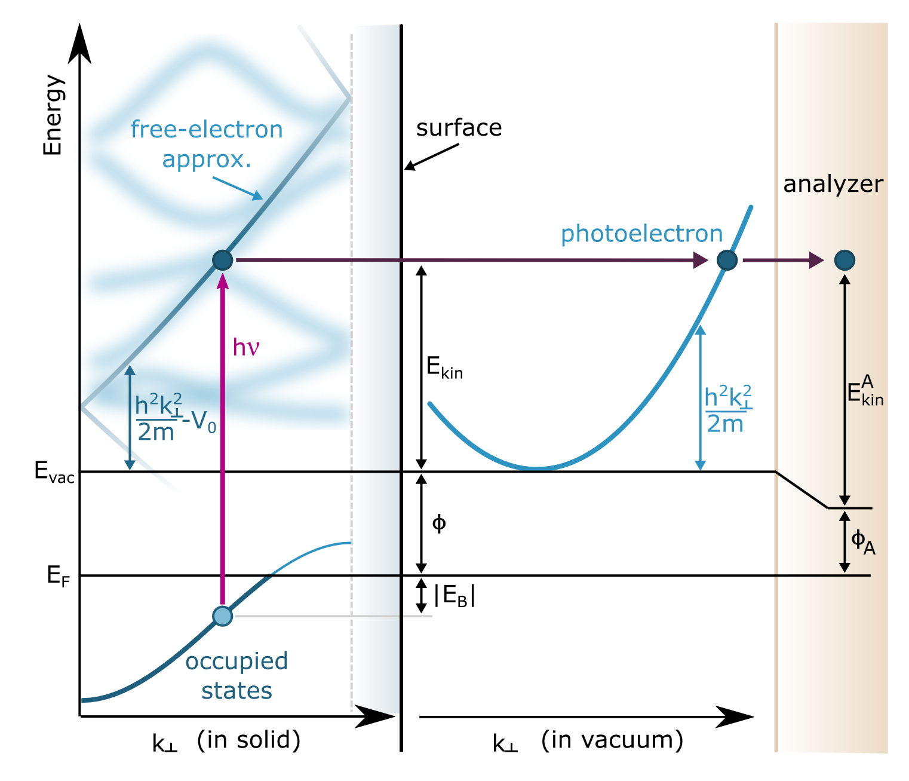


Angle-resolved photoemission spectroscopy(ARPES)

Slide 5
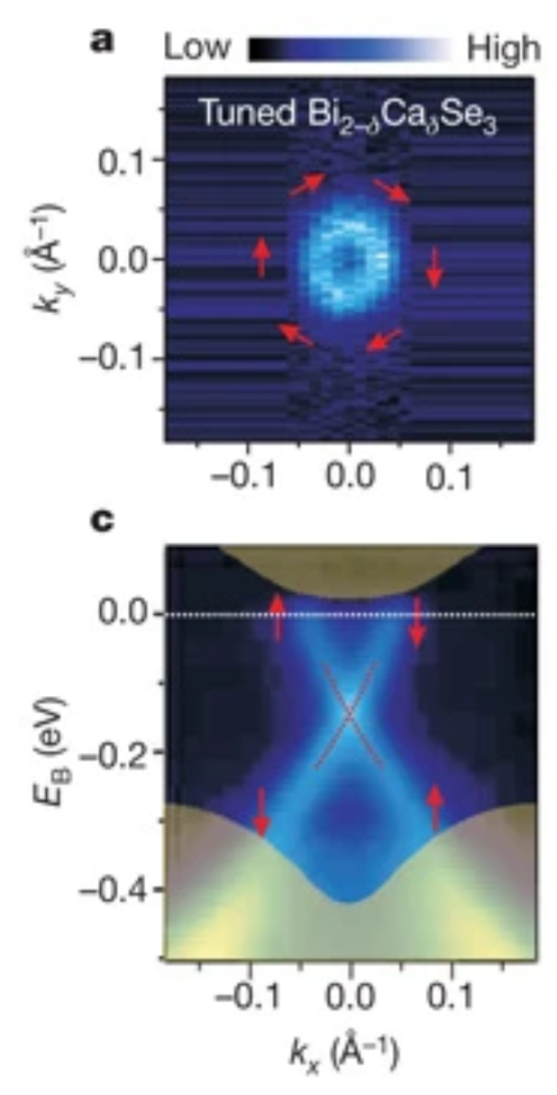
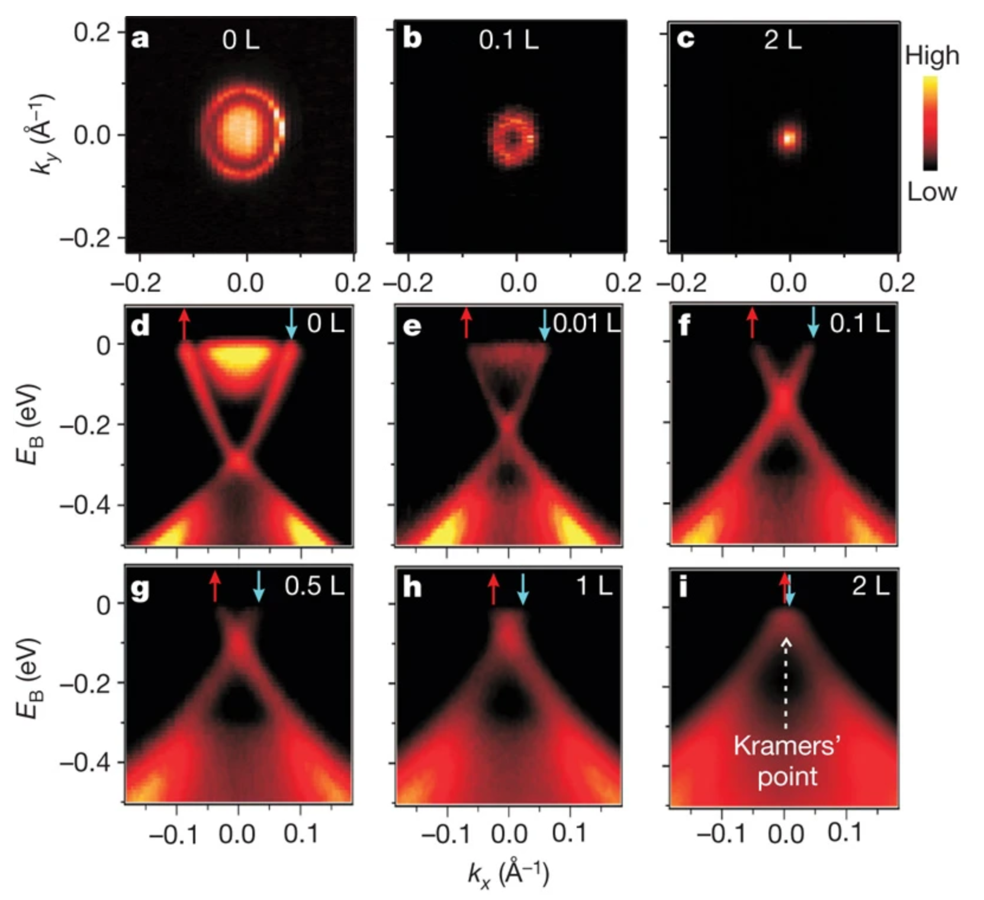
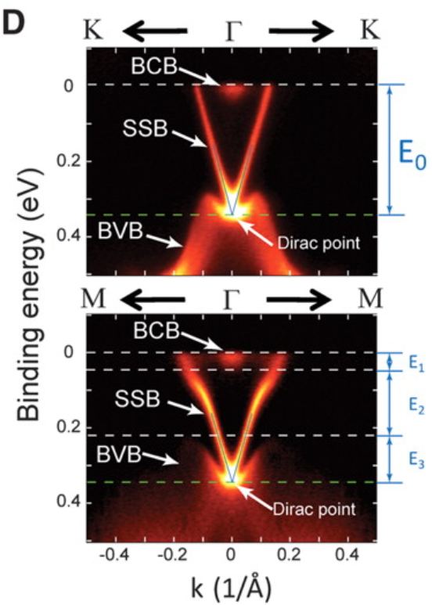
The Dirac SS in Bi₂Se₃ family
Bi₂Se₃
Bi₂Te₃
D. Hsieh et al., Nature 460, 1101 (2009)
Y. L. Chen et al., Science 325, 178 (2009)
Dirac surface states of 3D TIs are observed in ARPES.

Slide 6
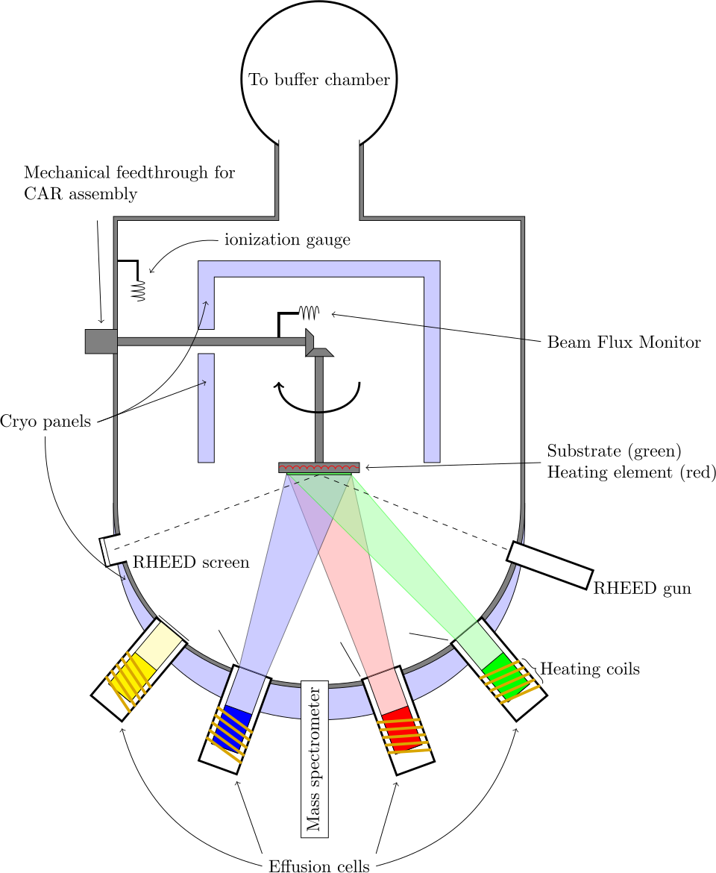
Molecular Beam Epitaxy (MBE)
Slow growth rate (0.2nm/min)
Ultra-high vacuum (10^-10 mbar)
Thickness/interface engineering

Slide 7
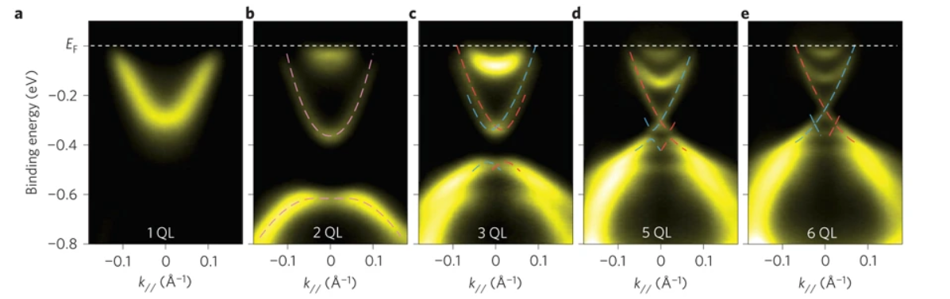
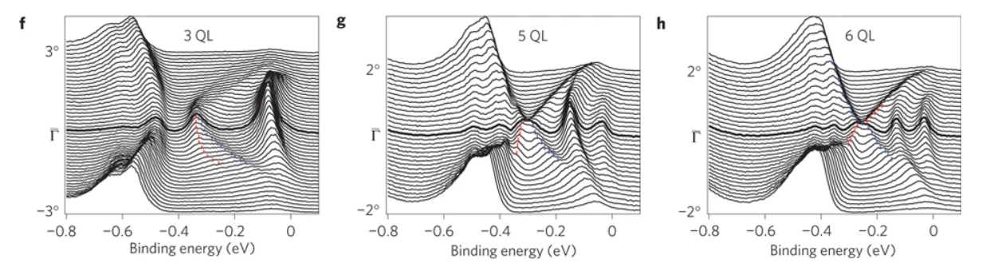
Crossover from 2D to 3D of Bi₂Se₃
Zhang, Y., He, K., Chang, CZ. et al. Nature Phys 6, 584–588 (2010).

Slide 8
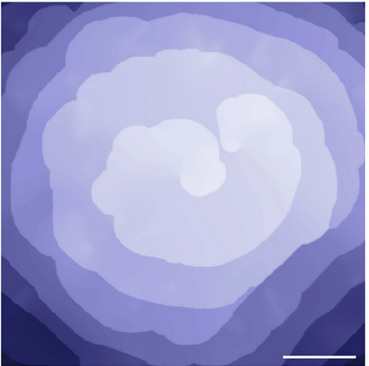
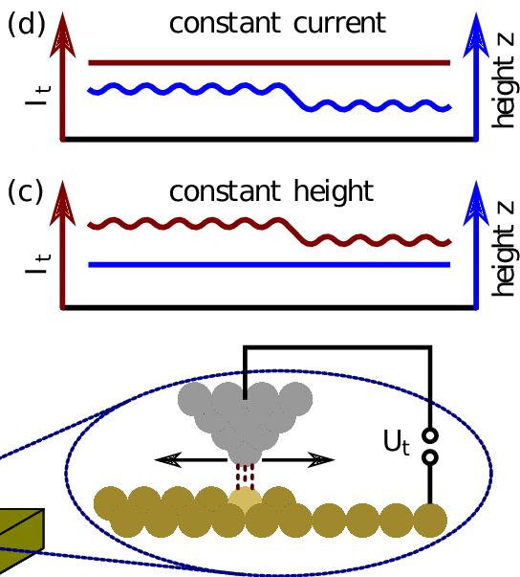
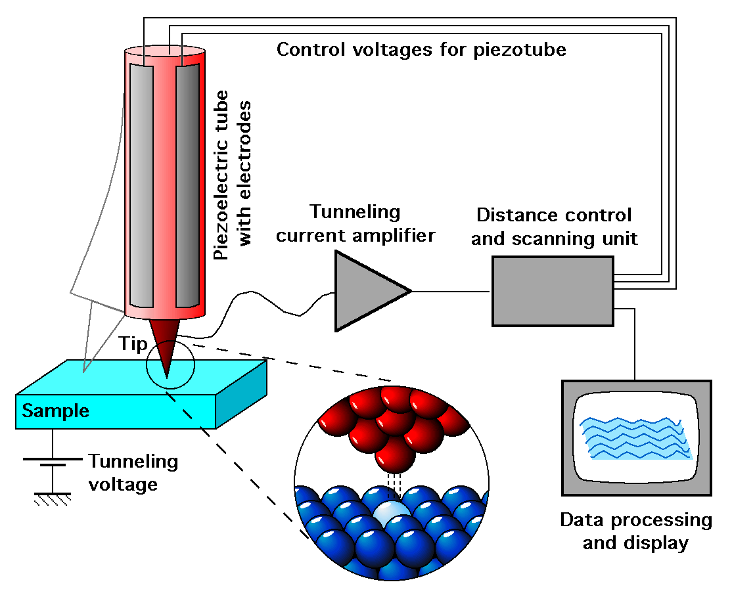
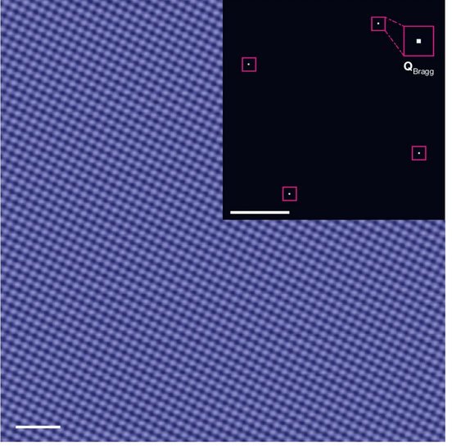

Scanning Tunneling Microscope
Tunneling current depends on tip-sample distance.
Fixing current -> fixing tip-sample distance -> Tip reads surface morphology

Slide 9
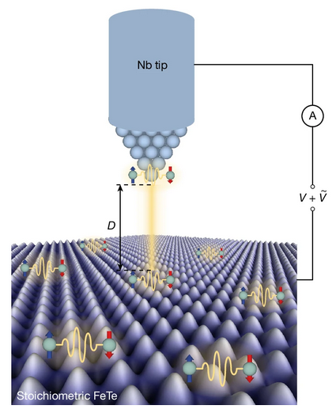
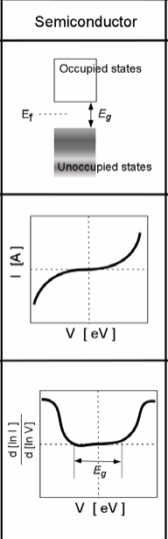
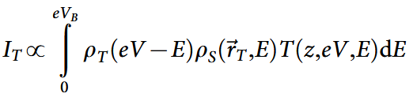
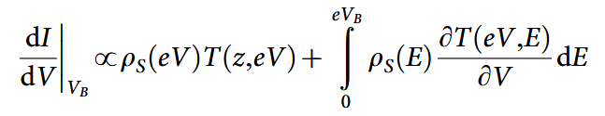
Scanning Tunneling Spectroscopy (STS)
I is continuous recorded with changing voltage bias.
Differential conductance (dI/dV) resolves local density of states

Slide 10
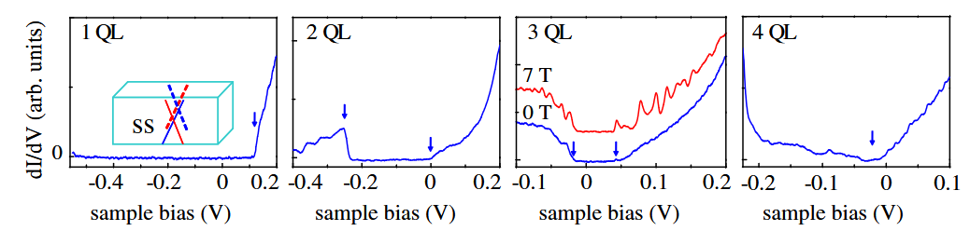
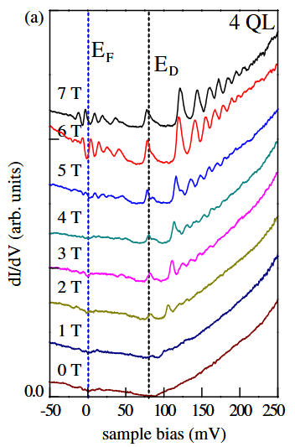
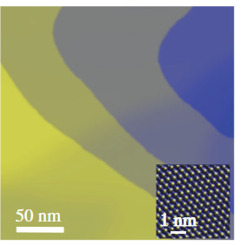
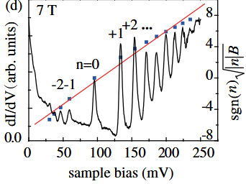
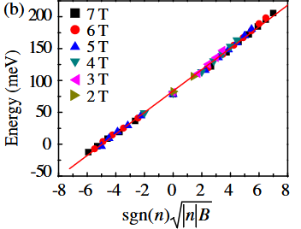
Landau quantization in Sb₂Te₃
Landau levels are revealed in the STM/S measurements under high B field.

Slide 11
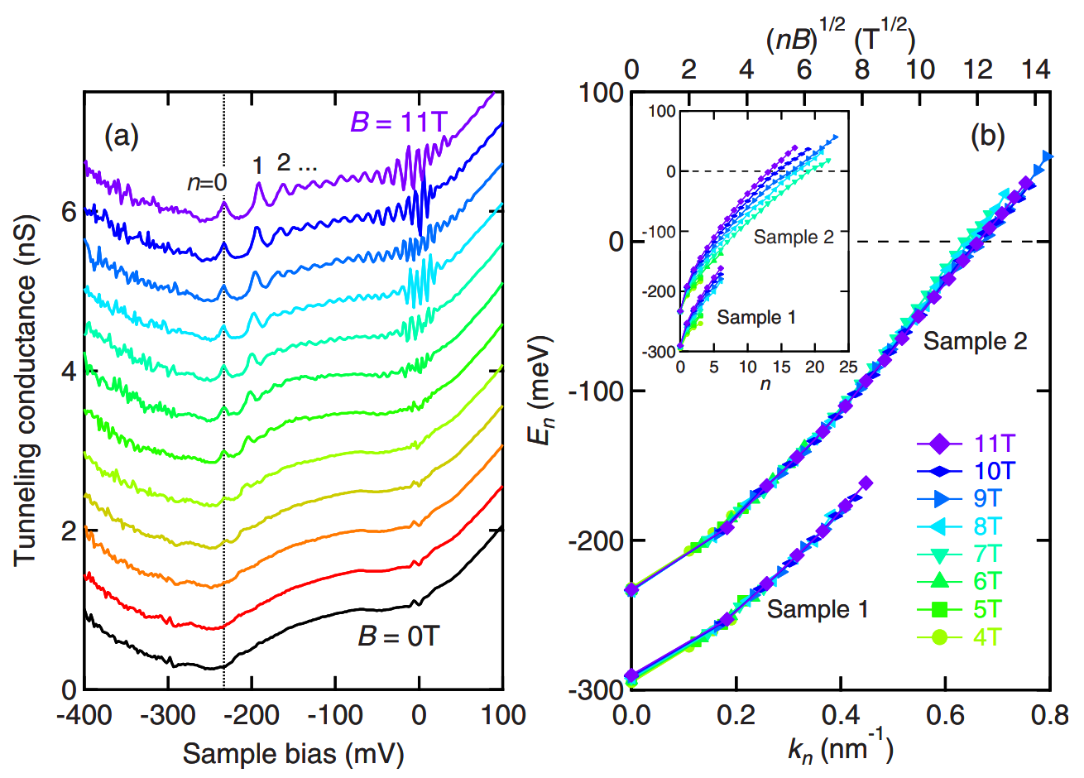
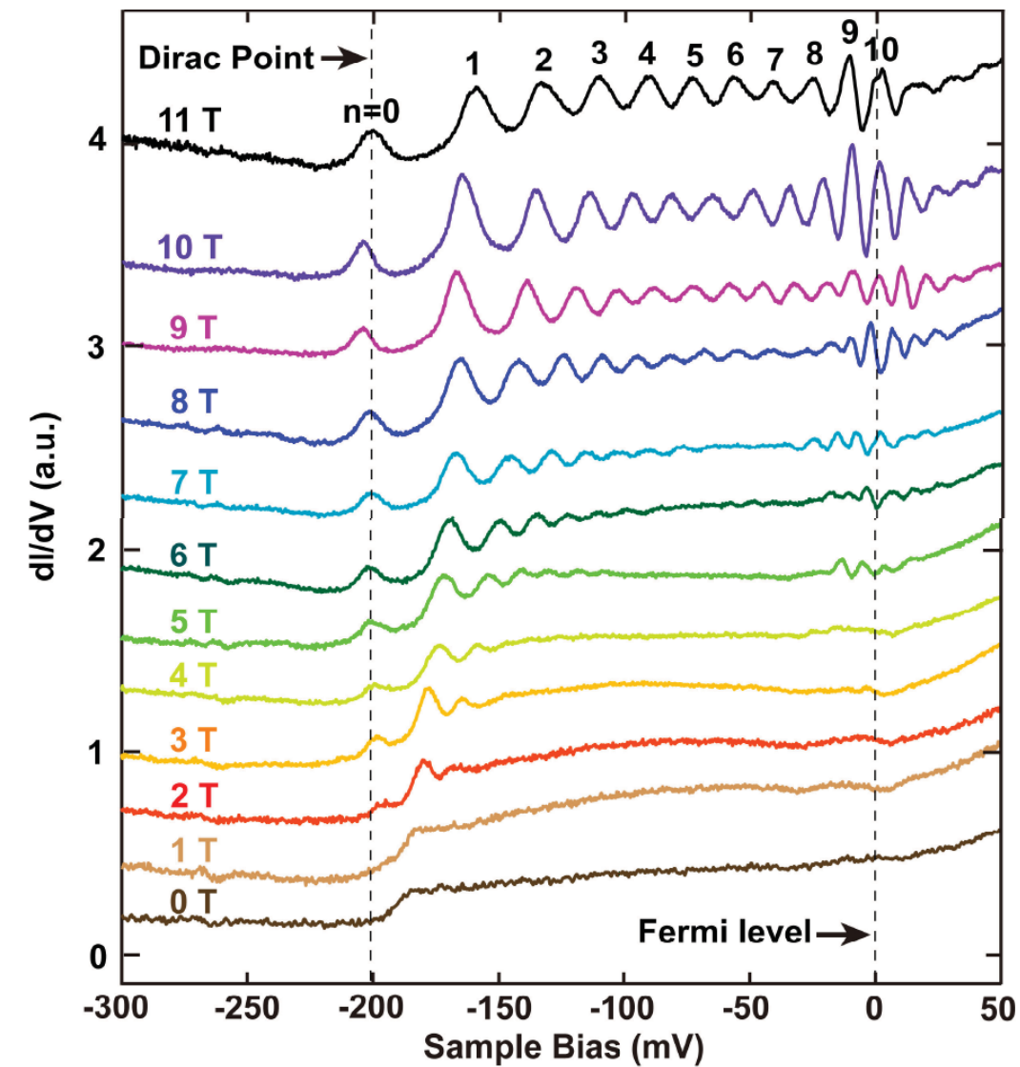
Landau quantization in Bi₂Se₃
Xue group
Bi₂Se₃ film
PRL 105, 076801 (2010)
Sasagawa group
Bi₂Se₃ crystal
PRB 82, 081305R 2010

Slide 12
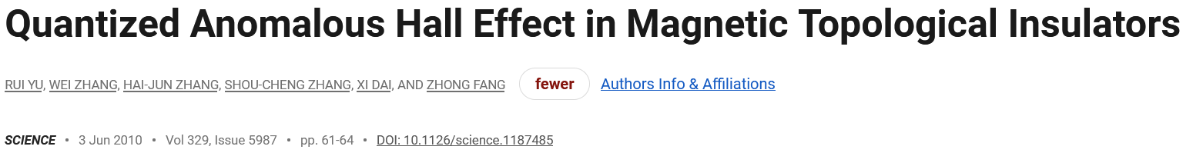
(i) Inverted band structure
Conditions of QAH effect
Topological Insulator
(ii) Ferromagnetic insulator
Conduction Band
Conduction Band
+ Ferromagnetic order
E_{F}
Valence Band
Valence Band
Inverted band structure

Slide 13
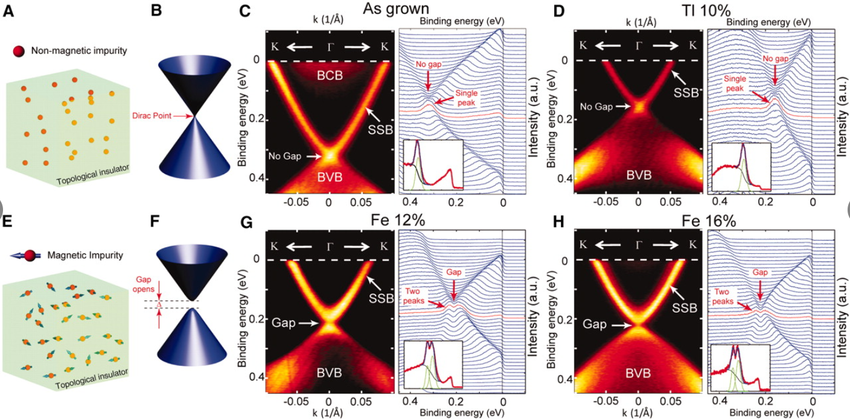
Magnetic exchange gap in Fe-doped Bi₂Se₃
Y. L. Chen et al. Science, 329,659-662(2010)

Slide 14
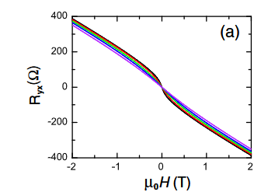
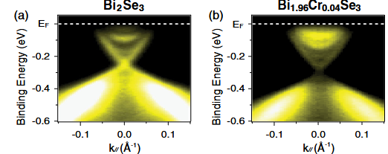
Magnetic exchange gap in Cr-doped Bi₂Se₃
Magnetic exchange gap observed in both Fe and Cr-doped Bi2Se3.
No long range FM order is observed.
C.Z Chang, et al. Phys. Rev. Lett., 112.5 (2014): 056801.

Slide 15
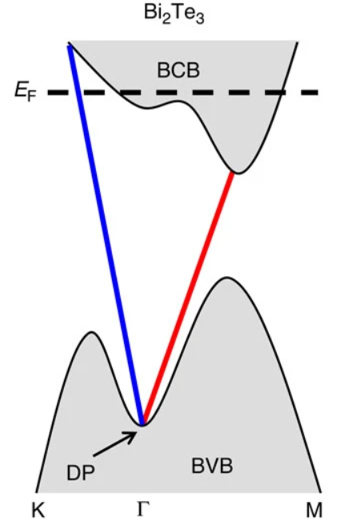
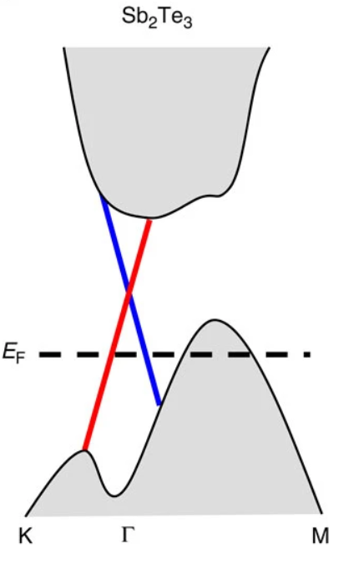
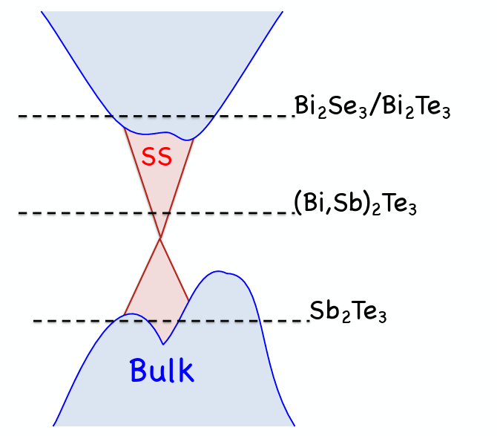
Zhang, J., Chang, CZ., Zhang, Z. et al. Nat Commun 2, 574 (2011)

Slide 16
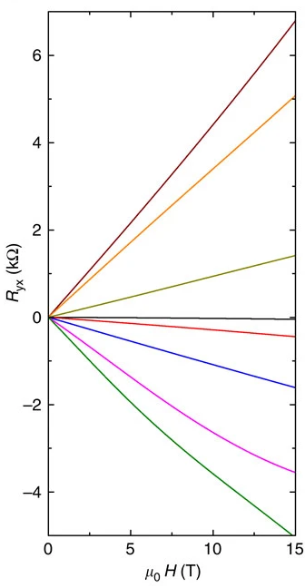
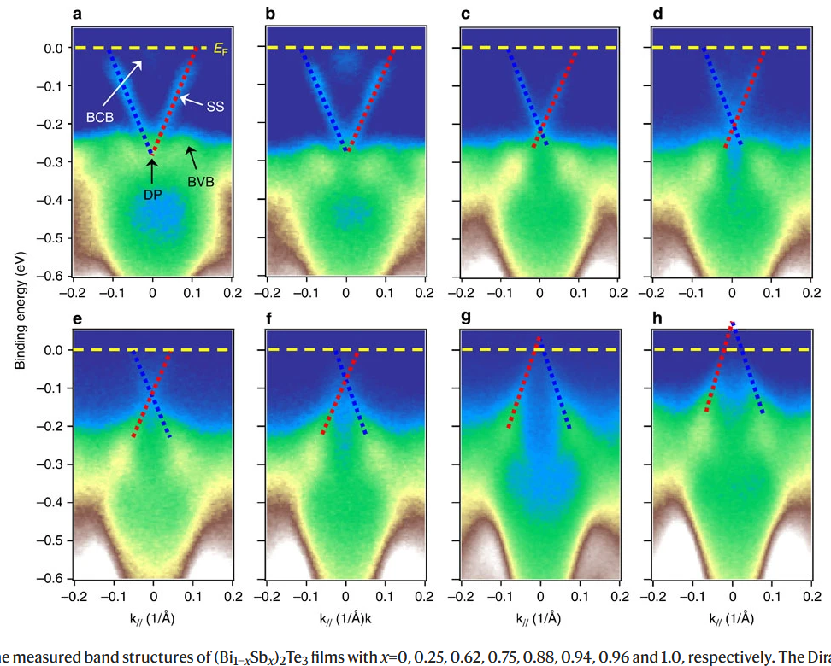
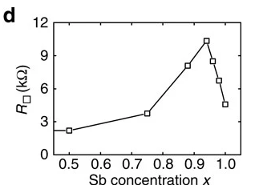
Band engineering of (Bi_{1-x}Sb_{x})₂Te₃
Zhang, J., Chang, CZ., Zhang, Z. et al. Nat Commun 2, 574 (2011)

Slide 17
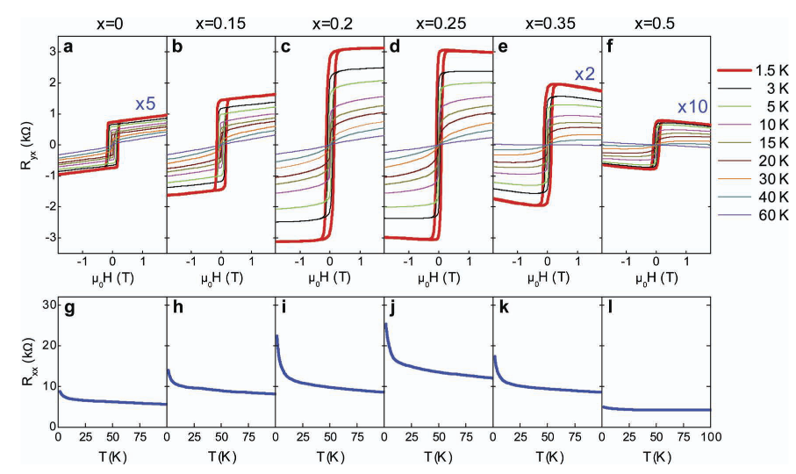
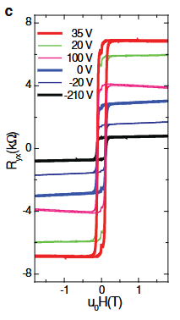
Long-range FM order and Giant AHE in Cr-doped (Bi_{1-x}Sb_{x})₂Te₃
Long range FM order is achieved in Cr-doped (Bi_{1-x}Sb_{x})₂Te₃ .
C.Z. Chang, et al., Adv. Mater., 25: 1065-1070.

Slide 18
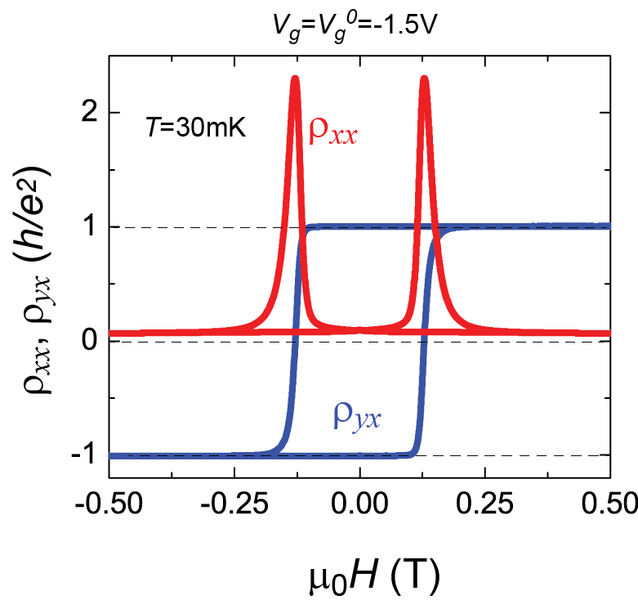
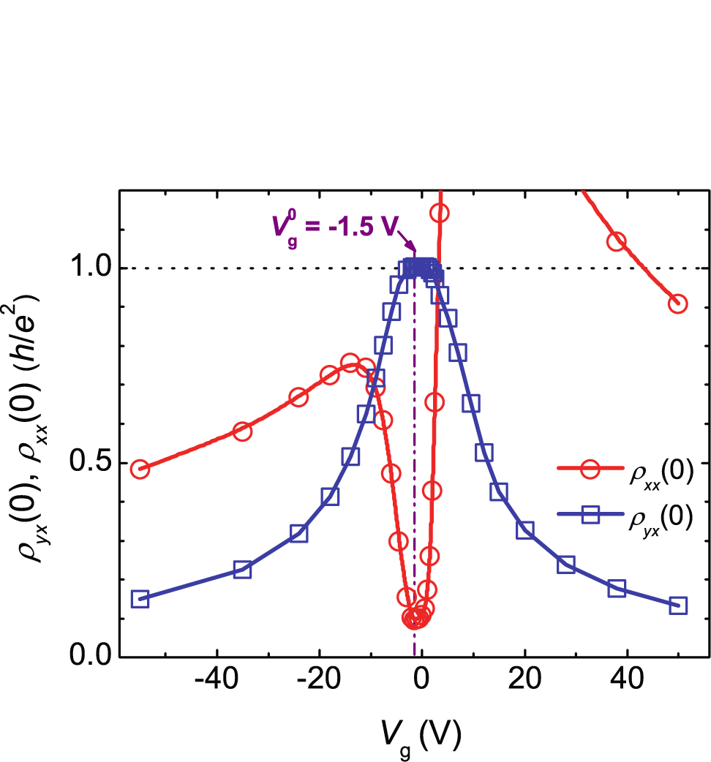


QAH effect in Cr-doped TI films
5QL Cr_{0.15} (Bi_{0.1}Sb_{0.9})_{1.85}Te₃ film
$$ρ_{yx}=1\frac{h}{e^{2}}$$
QAH effect with Chern number C = 1
$$ρ_{xx}\sim 2.53 kΩ$$
Chang et al., Science 340,167 (2013)

Slide 19
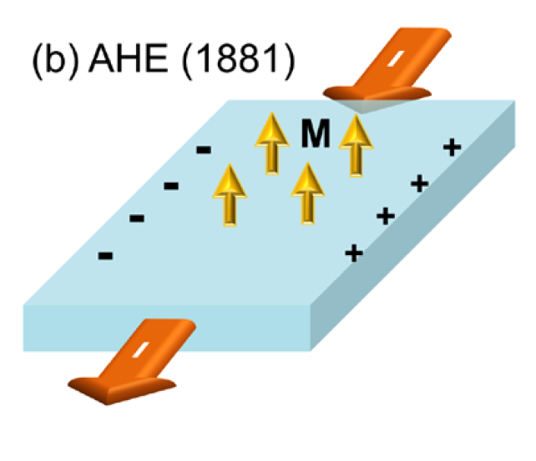
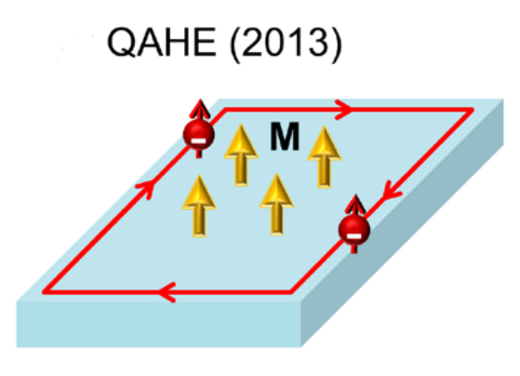



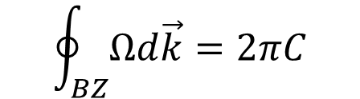
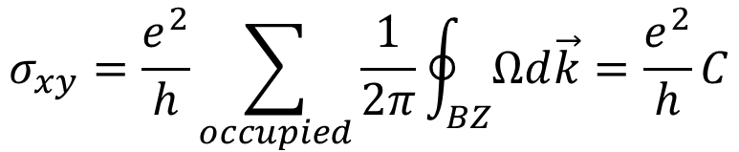
From Anomalous Hall effect (AHE) to QAH effect
ρ_{yx}
ρ_{yx}
$\frac{h}{e^{2}}$
μ₀H
μ₀H
Chang et al., J. Phys. Condens. Mater. 28, 123002 (2016)
Intrinsic AHE: induced by energy band
$$σ_{xy}=\frac{e^{2}}{h}\sum_{occupied}{\frac{1}{2π}\oint_{BZ}^{ }{Ωd\vec{k}}}=\frac{e^{2}}{h}C$$
$$σ_{xy}=\frac{e^{2}}{h}C$$
$$\oint_{BZ}^{ }{Ωd\vec{k}}=2πC$$
$C$ $≠0$ QAHE
Karplus et al., Phys. Rev. 95,1154 (1954)

Slide 20
